Slide 1
ISO 27000 SERIES
International Organization for Standardization

Slide 2
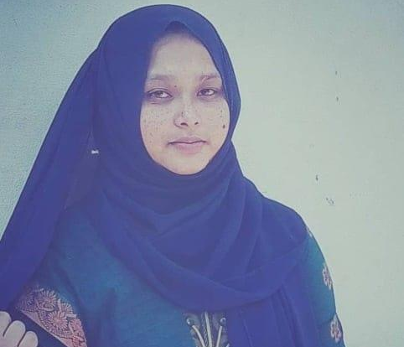
ABOUT me
This is Rukya Islam,undergraduate student at Daffodil International University.
student_id:192-15-13319

Slide 3
HISTORY
In 1946, delegates from 25 countries met in London to create a new international standards organization. In 1947 the new organization, ISO, began operations. The name ISO is derived from the Greek word “isos,” meaning equal.

Slide 4
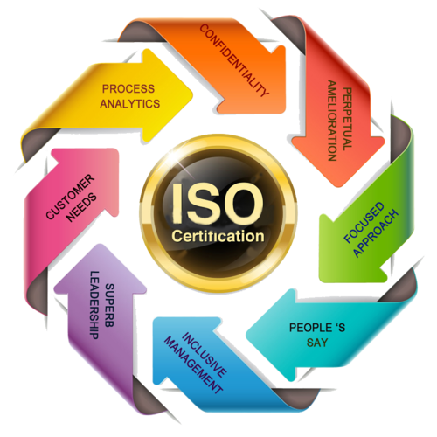

ABOUT ISO
The International Organization for Standardization (ISO) is an international nongovernmental organization made up of national standards bodies; it develops and publishes a wide range of proprietary, industrial, and commercial standards and is comprised of representatives from various national standards organizations

Slide 5
What Is ISO/IEC 27000?
Also known as the ISO 27000 Family of Standards, it’s a series of information security standards that provide a global framework for information security management practices. (IEC).

Slide 6
Why Use the ISO 27000 Series Standards?

Slide 7

What Are the Advantages of Following ISO 27000 Series
allows an organization to protect business-critical data
accepted global benchmark for the effective management of information assets.
to assist companies in managing cyber attack risks and internal data security threatt
It’s the closest planet to the Sun and the smallest

Slide 8
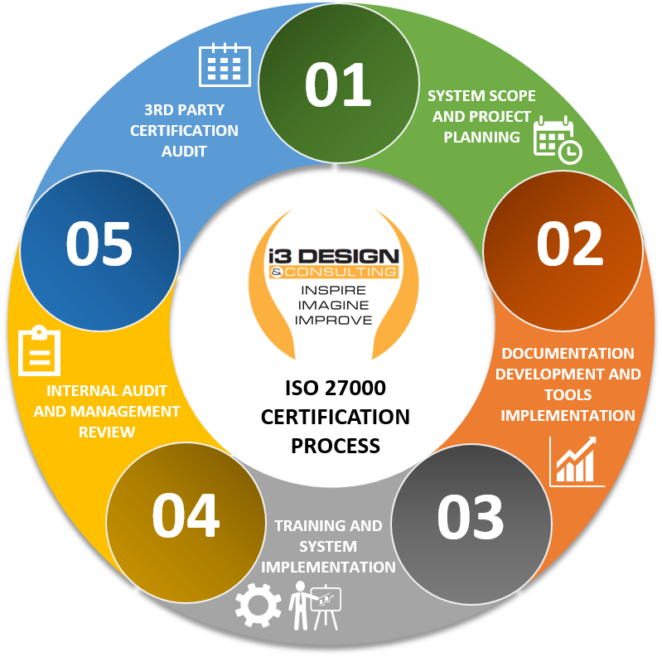
ISO CERTIFICATIONS

Slide 9
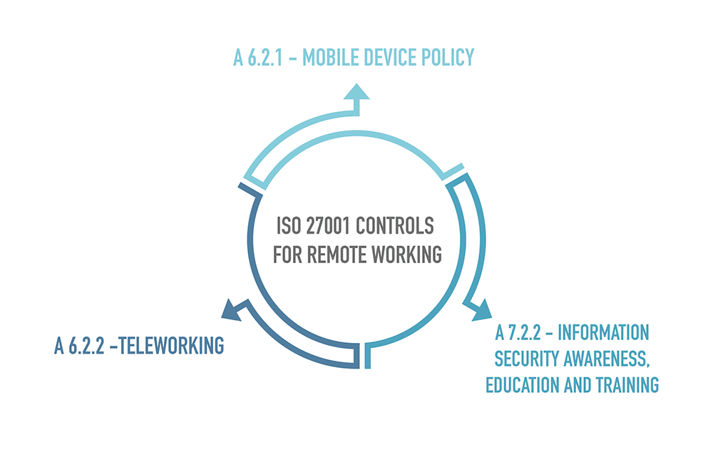
Two of the controls from ISO 27001/ISO 27002 are dedicated to teleworking: A.6.2.1 Mobile device policy, and A.6.2.2 Teleworking

Slide 10
Cybersecurity Framework
ISO 27001
Which one to go with?

Slide 11
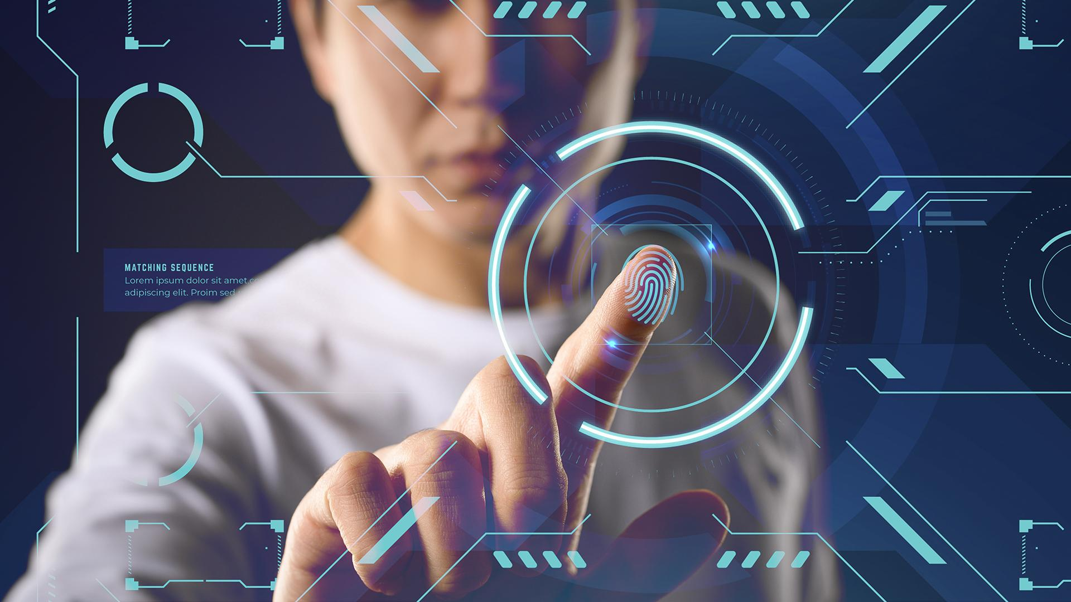
AWESOME WORDS

Slide 12
THANKS!
Do you have any questions?
rukya15-13319@diu.edu.bd
contact: 01740844603
https://portfolio-of-rukyaislam.netlify.app/

